Slide 1
Evaluating clustering
CSCI 347
Adiesha Liyana Ralalage

Slide 2
Clustering validation
It is important to develop approaches to assess clustering results.
This process has three main tasks:
Clustering evaluation: assess goodness or quality of the clustering
Clustering stability: assess the sensitivity of the clustering results to various algorithmic parameters.
Clustering tendency: assessing the suitability of applying clustering in the first place, e.g., whether the data has inherent grouping structures.

Slide 3
Clustering validation
There are three types of validation.
External: External validation measures employ criteria that are not inherent to the dataset. E.g., class labels for each point.
Internal: Internal validation measures employ criteria that are derived from the data itself.
we can use intra-cluster and inter-cluster distances to obtain measures of cluster compactness (e.g., how similar are the points in the same cluster) and separation (e.g., how far apart are the points in different clusters).
Relative: Relative validation measures aim to directly compare different clustering, usually those obtained via different parameter settings for the same algorithm.

Slide 4
Evaluating clustering: the F-Score
CSCI 347
Adiesha Liyana Ralalage

Slide 5
F-Score
External measure.
Assumes that the correct or ground-truth clustering is known a priori.
Ground truth plays the role of external information to evaluate clustering.
External evaluation measures try capture the extent to which points from the same partition appear in the same cluster, and the extent to which points from different partitions are grouped in different clusters.

Slide 6
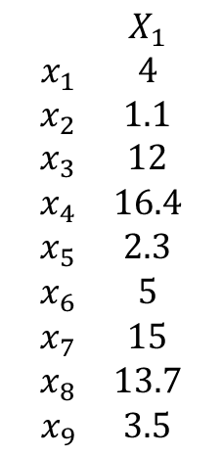
Example
$1$-dimensional example
$$\begin{matrix} & X_{1} \\ x_{1} & 4 \\ x_{2} & 1.1 \\ x_{3} & 12 \\ x_{4} & 16.4 \\ x_{5} & 2.3 \\ x_{6} & 5 \\ x_{7} & 15 \\ x_{8} & 13.7 \\ x_{9} & 3.5\end{matrix}$$
-1
0
1
2
3
4
5
6
7
8
9
10
11
12
13
14
15
16
17
18
19
20
21
22
Looks like the true clusters.

Slide 7
Example
$$𝒞=\left\{C_{1},C_{2}\right\}=\left\{\left\{x_{1},x_{2},x_{5},x_{9}\right\},\left\{x_{3},x_{4},x_{6},x_{7},x_{8}\right\}\right\}$$
$1$-dimensional example
$$\begin{matrix} & X_{1} \\ x_{1} & 4 \\ x_{2} & 1.1 \\ x_{3} & 12 \\ x_{4} & 16.4 \\ x_{5} & 2.3 \\ x_{6} & 5 \\ x_{7} & 15 \\ x_{8} & 13.7 \\ x_{9} & 3.5\end{matrix}$$
-1
0
1
2
3
4
5
6
7
8
9
10
11
12
13
14
15
16
17
18
19
20
21
22
$$𝒯=\left\{T_{1},T_{2}\right\}=\left\{\left\{x_{1},x_{2},x_{5},{x_{6},x}_{9}\right\},\left\{x_{3},x_{4}, x_{7},x_{8}\right\}\right\}$$

Slide 8
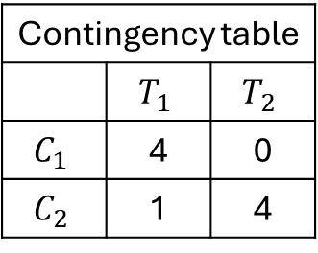



Precision
$$n_{1}=4$$
$$n_{2}=5$$
$$𝒞=\left\{C_{1},C_{2}\right\}=\left\{\left\{x_{1},x_{2},x_{5},x_{9}\right\},\left\{x_{3},x_{4},x_{6},x_{7},x_{8}\right\}\right\}$$
$1$-dimensional example
$$\begin{matrix} & X_{1} \\ x_{1} & 4 \\ x_{2} & 1.1 \\ x_{3} & 12 \\ x_{4} & 16.4 \\ x_{5} & 2.3 \\ x_{6} & 5 \\ x_{7} & 15 \\ x_{8} & 13.7 \\ x_{9} & 3.5\end{matrix}$$
-1
0
1
2
3
4
5
6
7
8
9
10
11
12
13
14
15
16
17
18
19
20
21
22
$$𝒯=\left\{T_{1},T_{2}\right\}=\left\{\left\{x_{1},x_{2},x_{5},{x_{6},x}_{9}\right\},\left\{x_{3},x_{4}, x_{7},x_{8}\right\}\right\}$$
Contingency table
 | $$T_{1}$$ | $$T_{2}$$
$$C_{1}$$ | 4 | 0
$$C_{2}$$ | 1 | 4
$$n_{ij}=\left|C_{i}∩T_{j}\right|$$

Slide 9
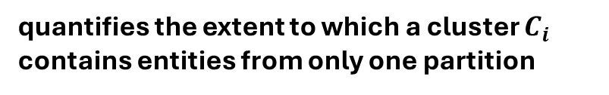
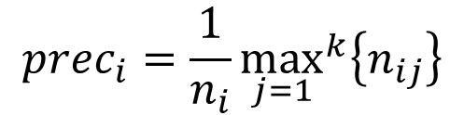
Precision
$$n_{1}=4$$
$$n_{2}=5$$
$$𝒞=\left\{C_{1},C_{2}\right\}=\left\{\left\{x_{1},x_{2},x_{5},x_{9}\right\},\left\{x_{3},x_{4},x_{6},x_{7},x_{8}\right\}\right\}$$
$1$-dimensional example
$$\begin{matrix} & X_{1} \\ x_{1} & 4 \\ x_{2} & 1.1 \\ x_{3} & 12 \\ x_{4} & 16.4 \\ x_{5} & 2.3 \\ x_{6} & 5 \\ x_{7} & 15 \\ x_{8} & 13.7 \\ x_{9} & 3.5\end{matrix}$$
-1
0
1
2
3
4
5
6
7
8
9
10
11
12
13
14
15
16
17
18
19
20
21
22
$$𝒯=\left\{T_{1},T_{2}\right\}=\left\{\left\{x_{1},x_{2},x_{5},{x_{6},x}_{9}\right\},\left\{x_{3},x_{4}, x_{7},x_{8}\right\}\right\}$$
Contingency table
 | $$T_{1}$$ | $$T_{2}$$
$$C_{1}$$ | 4 | 0
$$C_{2}$$ | 1 | 4
$$prec_{i}=\frac{1}{n_{i}}{\max_{j=1}}^{k}\left\{n_{ij}\right\}$$
quantifies the extent to which a cluster $C_{i}$ contains entities from only one partition
$$n_{ij}=\left|C_{i}∩T_{j}\right|$$

Slide 10
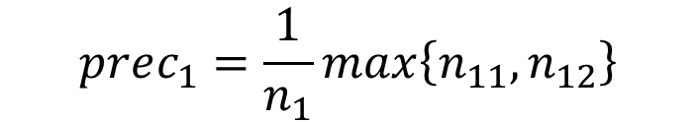
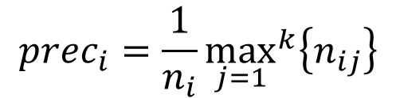
Precision
$$n_{1}=4$$
$$n_{2}=5$$
$$𝒞=\left\{C_{1},C_{2}\right\}=\left\{\left\{x_{1},x_{2},x_{5},x_{9}\right\},\left\{x_{3},x_{4},x_{6},x_{7},x_{8}\right\}\right\}$$
$1$-dimensional example
$$\begin{matrix} & X_{1} \\ x_{1} & 4 \\ x_{2} & 1.1 \\ x_{3} & 12 \\ x_{4} & 16.4 \\ x_{5} & 2.3 \\ x_{6} & 5 \\ x_{7} & 15 \\ x_{8} & 13.7 \\ x_{9} & 3.5\end{matrix}$$
-1
0
1
2
3
4
5
6
7
8
9
10
11
12
13
14
15
16
17
18
19
20
21
22
$$𝒯=\left\{T_{1},T_{2}\right\}=\left\{\left\{x_{1},x_{2},x_{5},{x_{6},x}_{9}\right\},\left\{x_{3},x_{4}, x_{7},x_{8}\right\}\right\}$$
Contingency table
 | $$T_{1}$$ | $$T_{2}$$
$$C_{1}$$ | 4 | 0
$$C_{2}$$ | 1 | 4
$$prec_{i}=\frac{1}{n_{i}}{\max_{j=1}}^{k}\left\{n_{ij}\right\}$$
$$prec_{1}=\frac{1}{n_{1}}\max\left\{n_{11}, n_{12}\right\}$$
$$n_{ij}=\left|C_{i}∩T_{j}\right|$$

Slide 11
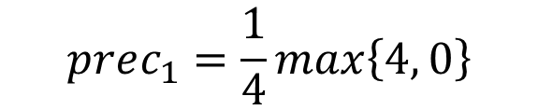
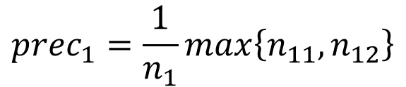
Precision
$$n_{1}=4$$
$$n_{2}=5$$
$$𝒞=\left\{C_{1},C_{2}\right\}=\left\{\left\{x_{1},x_{2},x_{5},x_{9}\right\},\left\{x_{3},x_{4},x_{6},x_{7},x_{8}\right\}\right\}$$
$1$-dimensional example
$$\begin{matrix} & X_{1} \\ x_{1} & 4 \\ x_{2} & 1.1 \\ x_{3} & 12 \\ x_{4} & 16.4 \\ x_{5} & 2.3 \\ x_{6} & 5 \\ x_{7} & 15 \\ x_{8} & 13.7 \\ x_{9} & 3.5\end{matrix}$$
-1
0
1
2
3
4
5
6
7
8
9
10
11
12
13
14
15
16
17
18
19
20
21
22
$$𝒯=\left\{T_{1},T_{2}\right\}=\left\{\left\{x_{1},x_{2},x_{5},{x_{6},x}_{9}\right\},\left\{x_{3},x_{4}, x_{7},x_{8}\right\}\right\}$$
Contingency table
 | $$T_{1}$$ | $$T_{2}$$
$$C_{1}$$ | 4 | 0
$$C_{2}$$ | 1 | 4
$$prec_{i}=\frac{1}{n_{i}}{\max_{j=1}}^{k}\left\{n_{ij}\right\}$$
$$prec_{1}=\frac{1}{n_{1}}\max\left\{n_{11}, n_{12}\right\}$$
$$prec_{1}=\frac{1}{4}\max\left\{4, 0\right\}$$
$$n_{ij}=\left|C_{i}∩T_{j}\right|$$

Slide 12
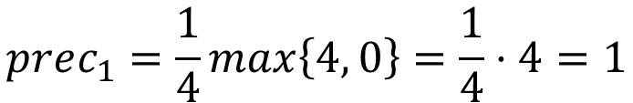
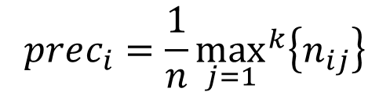
Precision
$$n_{1}=4$$
$$n_{2}=5$$
$$𝒞=\left\{C_{1},C_{2}\right\}=\left\{\left\{x_{1},x_{2},x_{5},x_{9}\right\},\left\{x_{3},x_{4},x_{6},x_{7},x_{8}\right\}\right\}$$
$1$-dimensional example
$$\begin{matrix} & X_{1} \\ x_{1} & 4 \\ x_{2} & 1.1 \\ x_{3} & 12 \\ x_{4} & 16.4 \\ x_{5} & 2.3 \\ x_{6} & 5 \\ x_{7} & 15 \\ x_{8} & 13.7 \\ x_{9} & 3.5\end{matrix}$$
-1
0
1
2
3
4
5
6
7
8
9
10
11
12
13
14
15
16
17
18
19
20
21
22
$$𝒯=\left\{T_{1},T_{2}\right\}=\left\{\left\{x_{1},x_{2},x_{5},{x_{6},x}_{9}\right\},\left\{x_{3},x_{4}, x_{7},x_{8}\right\}\right\}$$
Contingency table
 | $$T_{1}$$ | $$T_{2}$$
$$C_{1}$$ | 4 | 0
$$C_{2}$$ | 1 | 4
$$prec_{i}=\frac{1}{n}{\max_{j=1}}^{k}\left\{n_{ij}\right\}$$
$$prec_{1}=\frac{1}{n_{1}}\max\left\{n_{11}, n_{12}\right\}$$
$$prec_{1}=\frac{1}{4}\max\left\{4, 0\right\}=\frac{1}{4}⋅4=1$$
$$n_{ij}=\left|C_{i}∩T_{j}\right|$$

Slide 13
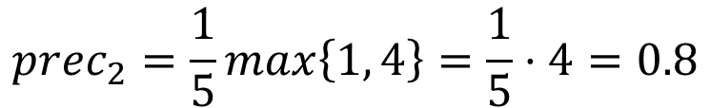
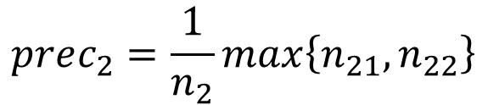
Precision
$$n_{1}=4$$
$$n_{2}=5$$
$$𝒞=\left\{C_{1},C_{2}\right\}=\left\{\left\{x_{1},x_{2},x_{5},x_{9}\right\},\left\{x_{3},x_{4},x_{6},x_{7},x_{8}\right\}\right\}$$
$1$-dimensional example
$$\begin{matrix} & X_{1} \\ x_{1} & 4 \\ x_{2} & 1.1 \\ x_{3} & 12 \\ x_{4} & 16.4 \\ x_{5} & 2.3 \\ x_{6} & 5 \\ x_{7} & 15 \\ x_{8} & 13.7 \\ x_{9} & 3.5\end{matrix}$$
-1
0
1
2
3
4
5
6
7
8
9
10
11
12
13
14
15
16
17
18
19
20
21
22
$$𝒯=\left\{T_{1},T_{2}\right\}=\left\{\left\{x_{1},x_{2},x_{5},{x_{6},x}_{9}\right\},\left\{x_{3},x_{4}, x_{7},x_{8}\right\}\right\}$$
Contingency table
 | $$T_{1}$$ | $$T_{2}$$
$$C_{1}$$ | 4 | 0
$$C_{2}$$ | 1 | 4
$$prec_{i}=\frac{1}{n}{\max_{j=1}}^{k}\left\{n_{ij}\right\}$$
$$prec_{2}=\frac{1}{n_{2}}\max\left\{n_{21}, n_{22}\right\}$$
$$prec_{2}=\frac{1}{5}\max\left\{1, 4\right\}=\frac{1}{5}⋅4=0.8$$
$$n_{ij}=\left|C_{i}∩T_{j}\right|$$

Slide 14
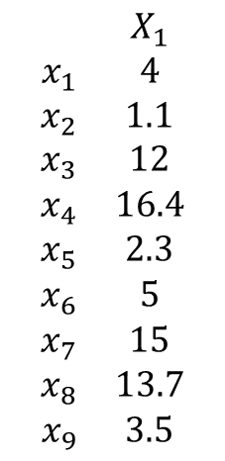
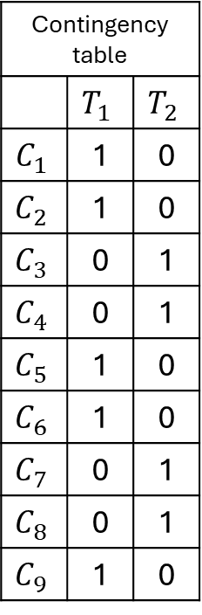
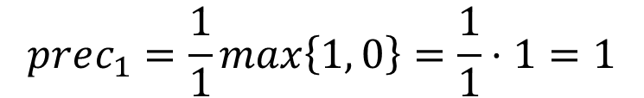
Precision
$$𝒞=\left\{C_{1},C_{2},C_{3},C_{4},C_{5},C_{6},C_{7},C_{8},C_{9}\right\}=\left\{\left\{x_{1}\right\},\left\{x_{2}\right\},\left\{x_{3}\right\},\left\{x_{4}\right\},\left\{x_{5}\right\},\left\{x_{6}\right\},\left\{x_{7}\right\},\left\{x_{8}\right\},\left\{x_{9}\right\},\right\}$$
$1$-dimensional example
$$\begin{matrix} & X_{1} \\ x_{1} & 4 \\ x_{2} & 1.1 \\ x_{3} & 12 \\ x_{4} & 16.4 \\ x_{5} & 2.3 \\ x_{6} & 5 \\ x_{7} & 15 \\ x_{8} & 13.7 \\ x_{9} & 3.5\end{matrix}$$
Contingency table
 | $$T_{1}$$ | $$T_{2}$$
$$C_{1}$$ | 1 | 0
$$C_{2}$$ | 1 | 0
$$C_{3}$$ | 0 | 1
$$C_{4}$$ | 0 | 1
$$C_{5}$$ | 1 | 0
$$C_{6}$$ | 1 | 0
$$C_{7}$$ | 0 | 1
$$C_{8}$$ | 0 | 1
$$C_{9}$$ | 1 | 0
-1
0
1
2
3
4
5
6
7
8
9
10
11
12
13
14
15
16
17
18
19
20
21
22
$$𝒯=\left\{T_{1},T_{2}\right\}=\left\{\left\{x_{1},x_{2},x_{5},{x_{6},x}_{9}\right\},\left\{x_{3},x_{4}, x_{7},x_{8}\right\}\right\}$$
$$prec_{i}=\frac{1}{n_{i}}{\max_{j=1}}^{k}\left\{n_{ij}\right\}$$
$$prec_{1}=\frac{1}{n_{1}}\max\left\{n_{11}, n_{12}\right\}$$
$$prec_{1}=\frac{1}{1}\max\left\{1, 0\right\}=\frac{1}{1}⋅1=1$$
$$n_{ij}=\left|C_{i}∩T_{j}\right|$$

Slide 15
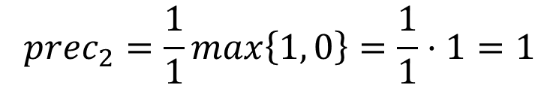
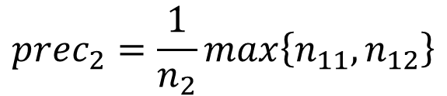
Precision
$$𝒞=\left\{C_{1},C_{2},C_{3},C_{4},C_{5},C_{6},C_{7},C_{8},C_{9}\right\}=\left\{\left\{x_{1}\right\},\left\{x_{2}\right\},\left\{x_{3}\right\},\left\{x_{4}\right\},\left\{x_{5}\right\},\left\{x_{6}\right\},\left\{x_{7}\right\},\left\{x_{8}\right\},\left\{x_{9}\right\},\right\}$$
$1$-dimensional example
$$\begin{matrix} & X_{1} \\ x_{1} & 4 \\ x_{2} & 1.1 \\ x_{3} & 12 \\ x_{4} & 16.4 \\ x_{5} & 2.3 \\ x_{6} & 5 \\ x_{7} & 15 \\ x_{8} & 13.7 \\ x_{9} & 3.5\end{matrix}$$
Contingency table
 | $$T_{1}$$ | $$T_{2}$$
$$C_{1}$$ | 1 | 0
$$C_{2}$$ | 1 | 0
$$C_{3}$$ | 0 | 1
$$C_{4}$$ | 0 | 1
$$C_{5}$$ | 1 | 0
$$C_{6}$$ | 1 | 0
$$C_{7}$$ | 0 | 1
$$C_{8}$$ | 0 | 1
$$C_{9}$$ | 1 | 0
-1
0
1
2
3
4
5
6
7
8
9
10
11
12
13
14
15
16
17
18
19
20
21
22
$$𝒯=\left\{T_{1},T_{2}\right\}=\left\{\left\{x_{1},x_{2},x_{5},{x_{6},x}_{9}\right\},\left\{x_{3},x_{4}, x_{7},x_{8}\right\}\right\}$$
$$prec_{i}=\frac{1}{n_{i}}{\max_{j=1}}^{k}\left\{n_{ij}\right\}$$
$$prec_{2}=\frac{1}{n_{2}}\max\left\{n_{11}, n_{12}\right\}$$
$$prec_{2}=\frac{1}{1}\max\left\{1, 0\right\}=\frac{1}{1}⋅1=1$$
$$n_{ij}=\left|C_{i}∩T_{j}\right|$$

Slide 16



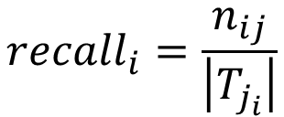

Recall
$$𝒞=\left\{C_{1},C_{2}\right\}=\left\{\left\{x_{1},x_{2},x_{5},x_{9}\right\},\left\{x_{3},x_{4},x_{6},x_{7},x_{8}\right\}\right\}$$
$1$-dimensional example
$$\begin{matrix} & X_{1} \\ x_{1} & 4 \\ x_{2} & 1.1 \\ x_{3} & 12 \\ x_{4} & 16.4 \\ x_{5} & 2.3 \\ x_{6} & 5 \\ x_{7} & 15 \\ x_{8} & 13.7 \\ x_{9} & 3.5\end{matrix}$$
-1
0
1
2
3
4
5
6
7
8
9
10
11
12
13
14
15
16
17
18
19
20
21
22
$$T_{1}=5$$
$$T_{2}=4$$
$$𝒯=\left\{T_{1},T_{2}\right\}=\left\{\left\{x_{1},x_{2},x_{5},{x_{6},x}_{9}\right\},\left\{x_{3},x_{4}, x_{7},x_{8}\right\}\right\}$$
Contingency table
 | $$T_{1}$$ | $$T_{2}$$
$$C_{1}$$ | 4 | 0
$$C_{2}$$ | 1 | 4
$$recall_{i}=\frac{n_{ij}}{\left|T_{j_{i}}\right|}$$
$$j_{i}=argmax_{j=1}^{k}\left\{n_{ij}\right\}$$
measures the fraction of point in partition $T_{ji}$ shared with cluster $C_{i}$ .
$$n_{ij}=\left|C_{i}∩T_{j}\right|$$

Slide 17

Recall
$$𝒞=\left\{C_{1},C_{2}\right\}=\left\{\left\{x_{1},x_{2},x_{5},x_{9}\right\},\left\{x_{3},x_{4},x_{6},x_{7},x_{8}\right\}\right\}$$
$1$-dimensional example
$$\begin{matrix} & X_{1} \\ x_{1} & 4 \\ x_{2} & 1.1 \\ x_{3} & 12 \\ x_{4} & 16.4 \\ x_{5} & 2.3 \\ x_{6} & 5 \\ x_{7} & 15 \\ x_{8} & 13.7 \\ x_{9} & 3.5\end{matrix}$$
-1
0
1
2
3
4
5
6
7
8
9
10
11
12
13
14
15
16
17
18
19
20
21
22
$$T_{1}=5$$
$$T_{2}=4$$
$$𝒯=\left\{T_{1},T_{2}\right\}=\left\{\left\{x_{1},x_{2},x_{5},{x_{6},x}_{9}\right\},\left\{x_{3},x_{4}, x_{7},x_{8}\right\}\right\}$$
Contingency table
 | $$T_{1}$$ | $$T_{2}$$
$$C_{1}$$ | 4 | 0
$$C_{2}$$ | 1 | 4
$$recall_{i}=\frac{n_{ij}}{\left|T_{j_{i}}\right|}$$
$$j_{i}=argmax_{j=1}^{k}\left\{n_{ij}\right\}$$
$$j_{1}=argmax_{j=1}^{k}\left\{n_{1j}\right\}=1$$
$$n_{ij}=\left|C_{i}∩T_{j}\right|$$

Slide 18

Recall
$$𝒞=\left\{C_{1},C_{2}\right\}=\left\{\left\{x_{1},x_{2},x_{5},x_{9}\right\},\left\{x_{3},x_{4},x_{6},x_{7},x_{8}\right\}\right\}$$
$1$-dimensional example
$$\begin{matrix} & X_{1} \\ x_{1} & 4 \\ x_{2} & 1.1 \\ x_{3} & 12 \\ x_{4} & 16.4 \\ x_{5} & 2.3 \\ x_{6} & 5 \\ x_{7} & 15 \\ x_{8} & 13.7 \\ x_{9} & 3.5\end{matrix}$$
-1
0
1
2
3
4
5
6
7
8
9
10
11
12
13
14
15
16
17
18
19
20
21
22
$$T_{1}=5$$
$$T_{2}=4$$
$$𝒯=\left\{T_{1},T_{2}\right\}=\left\{\left\{x_{1},x_{2},x_{5},{x_{6},x}_{9}\right\},\left\{x_{3},x_{4}, x_{7},x_{8}\right\}\right\}$$
Contingency table
 | $$T_{1}$$ | $$T_{2}$$
$$C_{1}$$ | 4 | 0
$$C_{2}$$ | 1 | 4
$$recall_{i}=\frac{n_{ij}}{\left|T_{j_{i}}\right|}$$
$$j_{i}=argmax_{j=1}^{k}\left\{n_{ij}\right\}$$
$$j_{1}=argmax_{j=1}^{k}\left\{n_{1j}\right\}=1$$
$${recall}_{1}=\frac{n_{11}}{\left|T_{1}\right|}$$
$$n_{ij}=\left|C_{i}∩T_{j}\right|$$

Slide 19

Recall
$$𝒞=\left\{C_{1},C_{2}\right\}=\left\{\left\{x_{1},x_{2},x_{5},x_{9}\right\},\left\{x_{3},x_{4},x_{6},x_{7},x_{8}\right\}\right\}$$
$1$-dimensional example
$$\begin{matrix} & X_{1} \\ x_{1} & 4 \\ x_{2} & 1.1 \\ x_{3} & 12 \\ x_{4} & 16.4 \\ x_{5} & 2.3 \\ x_{6} & 5 \\ x_{7} & 15 \\ x_{8} & 13.7 \\ x_{9} & 3.5\end{matrix}$$
-1
0
1
2
3
4
5
6
7
8
9
10
11
12
13
14
15
16
17
18
19
20
21
22
$$T_{1}=5$$
$$T_{2}=4$$
$$𝒯=\left\{T_{1},T_{2}\right\}=\left\{\left\{x_{1},x_{2},x_{5},{x_{6},x}_{9}\right\},\left\{x_{3},x_{4}, x_{7},x_{8}\right\}\right\}$$
Contingency table
 | $$T_{1}$$ | $$T_{2}$$
$$C_{1}$$ | 4 | 0
$$C_{2}$$ | 1 | 4
$$recall_{i}=\frac{n_{ij}}{\left|T_{j_{i}}\right|}$$
$$j_{i}=argmax_{j=1}^{k}\left\{n_{ij}\right\}$$
$$j_{1}=argmax_{j=1}^{k}\left\{n_{1j}\right\}=1$$
$${recall}_{1}=\frac{n_{11}}{\left|T_{1}\right|}$$
$${recall}_{1}=\frac{4}{5}=0.8$$
$$n_{ij}=\left|C_{i}∩T_{j}\right|$$

Slide 20
Exercise
$$𝒞=\left\{C_{1},C_{2}\right\}=\left\{\left\{x_{1},x_{2},x_{5},x_{9}\right\},\left\{x_{3},x_{4},x_{6},x_{7},x_{8}\right\}\right\}$$
$1$-dimensional example
$$\begin{matrix} & X_{1} \\ x_{1} & 4 \\ x_{2} & 1.1 \\ x_{3} & 12 \\ x_{4} & 16.4 \\ x_{5} & 2.3 \\ x_{6} & 5 \\ x_{7} & 15 \\ x_{8} & 13.7 \\ x_{9} & 3.5\end{matrix}$$
-1
0
1
2
3
4
5
6
7
8
9
10
11
12
13
14
15
16
17
18
19
20
21
22
$$T_{1}=5$$
$$T_{2}=4$$
$$𝒯=\left\{T_{1},T_{2}\right\}=\left\{\left\{x_{1},x_{2},x_{5},{x_{6},x}_{9}\right\},\left\{x_{3},x_{4}, x_{7},x_{8}\right\}\right\}$$
Contingency table
 | $$T_{1}$$ | $$T_{2}$$
$$C_{1}$$ | 4 | 0
$$C_{2}$$ | 1 | 4
$$recall_{i}=\frac{n_{ij}}{\left|T_{j_{i}}\right|}$$
$$j_{i}=argmax_{j=1}^{k}\left\{n_{ij}\right\}$$
$$n_{ij}=\left|C_{i}∩T_{j}\right|$$

Slide 21



Recall
$$𝒞=\left\{C_{1},C_{2}\right\}=\left\{\left\{x_{1},x_{2},x_{5},x_{9}\right\},\left\{x_{3},x_{4},x_{6},x_{7},x_{8}\right\}\right\}$$
$1$-dimensional example
$$\begin{matrix} & X_{1} \\ x_{1} & 4 \\ x_{2} & 1.1 \\ x_{3} & 12 \\ x_{4} & 16.4 \\ x_{5} & 2.3 \\ x_{6} & 5 \\ x_{7} & 15 \\ x_{8} & 13.7 \\ x_{9} & 3.5\end{matrix}$$
-1
0
1
2
3
4
5
6
7
8
9
10
11
12
13
14
15
16
17
18
19
20
21
22
$$T_{1}=5$$
$$T_{2}=4$$
$$𝒯=\left\{T_{1},T_{2}\right\}=\left\{\left\{x_{1},x_{2},x_{5},{x_{6},x}_{9}\right\},\left\{x_{3},x_{4}, x_{7},x_{8}\right\}\right\}$$
Contingency table
 | $$T_{1}$$ | $$T_{2}$$
$$C_{1}$$ | 4 | 0
$$C_{2}$$ | 1 | 4
$$recall_{i}=\frac{n_{ij}}{\left|T_{j_{i}}\right|}$$
$$j_{i}=argmax_{j=1}^{k}\left\{n_{ij}\right\}$$
$$j_{2}=argmax_{j=1}^{k}\left\{n_{2j}\right\}=2$$
$${recall}_{2}=\frac{n_{22}}{\left|T_{2}\right|}$$
$${recall}_{2}=\frac{4}{4}=1$$
$$n_{ij}=\left|C_{i}∩T_{j}\right|$$

Slide 22
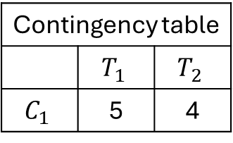

Recall
$$𝒞=\left\{C_{1} \right\}=\left\{\left\{x_{1},x_{2},x_{3},x_{4}, x_{5},x_{6},x_{7},x_{8},x_{9}\right\}\right\}$$
$1$-dimensional example
$$\begin{matrix} & X_{1} \\ x_{1} & 4 \\ x_{2} & 1.1 \\ x_{3} & 12 \\ x_{4} & 16.4 \\ x_{5} & 2.3 \\ x_{6} & 5 \\ x_{7} & 15 \\ x_{8} & 13.7 \\ x_{9} & 3.5\end{matrix}$$
-1
0
1
2
3
4
5
6
7
8
9
10
11
12
13
14
15
16
17
18
19
20
21
22
$$T_{1}=5$$
$$T_{2}=4$$
$$𝒯=\left\{T_{1},T_{2}\right\}=\left\{\left\{x_{1},x_{2},x_{5},{x_{6},x}_{9}\right\},\left\{x_{3},x_{4}, x_{7},x_{8}\right\}\right\}$$
Contingency table
 | $$T_{1}$$ | $$T_{2}$$
$$C_{1}$$ | 5 | 4
$$recall_{i}=\frac{n_{ij}}{\left|T_{j_{i}}\right|}$$
$$j_{i}=argmax_{j=1}^{k}\left\{n_{ij}\right\}$$
$$j_{1}=argmax_{j=1}^{k}\left\{n_{1j}\right\}=1$$
$${recall}_{1}=\frac{n_{11}}{\left|T_{1}\right|}$$
$${recall}_{1}=\frac{5}{5}=1$$
$$n_{ij}=\left|C_{i}∩T_{j}\right|$$

Slide 23


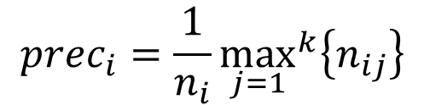
Exercise
$$𝒞=\left\{C_{1} \right\}=\left\{\left\{x_{1},x_{2},x_{3},x_{4}, x_{5},x_{6},x_{7},x_{8},x_{9}\right\}\right\}$$
$1$-dimensional example
$$\begin{matrix} & X_{1} \\ x_{1} & 4 \\ x_{2} & 1.1 \\ x_{3} & 12 \\ x_{4} & 16.4 \\ x_{5} & 2.3 \\ x_{6} & 5 \\ x_{7} & 15 \\ x_{8} & 13.7 \\ x_{9} & 3.5\end{matrix}$$
-1
0
1
2
3
4
5
6
7
8
9
10
11
12
13
14
15
16
17
18
19
20
21
22
$$T_{1}=5$$
$$T_{2}=4$$
$$𝒯=\left\{T_{1},T_{2}\right\}=\left\{\left\{x_{1},x_{2},x_{5},{x_{6},x}_{9}\right\},\left\{x_{3},x_{4}, x_{7},x_{8}\right\}\right\}$$
Contingency table
 | $$T_{1}$$ | $$T_{2}$$
$$C_{1}$$ | 5 | 4
$$recall_{i}=\frac{n_{ij}}{\left|T_{j_{i}}\right|}$$
$$j_{i}=argmax_{j=1}^{k}\left\{n_{ij}\right\}$$
$$prec_{i}=\frac{1}{n_{i}}{\max_{j=1}}^{k}\left\{n_{ij}\right\}$$
$$n_{ij}=\left|C_{i}∩T_{j}\right|$$
$$What is the precision of C_{1}?$$

Slide 24
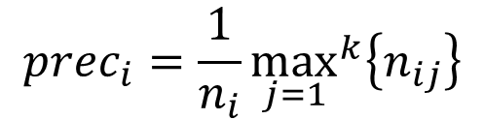



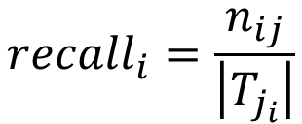
Exercise
$$𝒞=\left\{C_{1},C_{2},C_{3},C_{4},C_{5},C_{6},C_{7},C_{8},C_{9}\right\}=\left\{\left\{x_{1}\right\},\left\{x_{2}\right\},\left\{x_{3}\right\},\left\{x_{4}\right\},\left\{x_{5}\right\},\left\{x_{6}\right\},\left\{x_{7}\right\},\left\{x_{8}\right\},\left\{x_{9}\right\},\right\}$$
$1$-dimensional example
$$\begin{matrix} & X_{1} \\ x_{1} & 4 \\ x_{2} & 1.1 \\ x_{3} & 12 \\ x_{4} & 16.4 \\ x_{5} & 2.3 \\ x_{6} & 5 \\ x_{7} & 15 \\ x_{8} & 13.7 \\ x_{9} & 3.5\end{matrix}$$
Contingency table
 | $$T_{1}$$ | $$T_{2}$$
$$C_{1}$$ | 1 | 0
$$C_{2}$$ | 1 | 0
$$C_{3}$$ | 0 | 1
$$C_{4}$$ | 0 | 1
$$C_{5}$$ | 1 | 0
$$C_{6}$$ | 1 | 0
$$C_{7}$$ | 0 | 1
$$C_{8}$$ | 0 | 1
$$C_{9}$$ | 1 | 0
-1
0
1
2
3
4
5
6
7
8
9
10
11
12
13
14
15
16
17
18
19
20
21
22
$$𝒯=\left\{T_{1},T_{2}\right\}=\left\{\left\{x_{1},x_{2},x_{5},{x_{6},x}_{9}\right\},\left\{x_{3},x_{4}, x_{7},x_{8}\right\}\right\}$$
$$recall_{i}=\frac{n_{ij}}{\left|T_{j_{i}}\right|}$$
$$prec_{i}=\frac{1}{n_{i}}{\max_{j=1}}^{k}\left\{n_{ij}\right\}$$
$$j_{i}=argmax_{j=1}^{k}\left\{n_{ij}\right\}$$
$$What is the recall of C_{1}?$$
$$n_{ij}=\left|C_{i}∩T_{j}\right|$$

Slide 25

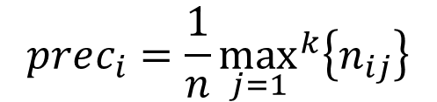
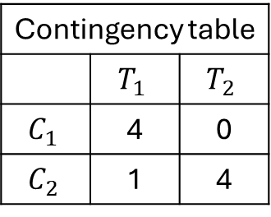

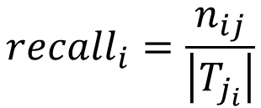
F-score
$$𝒞=\left\{C_{1},C_{2}\right\}=\left\{\left\{x_{1},x_{2},x_{5},x_{9}\right\},\left\{x_{3},x_{4},x_{6},x_{7},x_{8}\right\}\right\}$$
$1$-dimensional example
$$\begin{matrix} & X_{1} \\ x_{1} & 4 \\ x_{2} & 1.1 \\ x_{3} & 12 \\ x_{4} & 16.4 \\ x_{5} & 2.3 \\ x_{6} & 5 \\ x_{7} & 15 \\ x_{8} & 13.7 \\ x_{9} & 3.5\end{matrix}$$
-1
0
1
2
3
4
5
6
7
8
9
10
11
12
13
14
15
16
17
18
19
20
21
22
$$T_{1}=5$$
$$T_{2}=4$$
$$𝒯=\left\{T_{1},T_{2}\right\}=\left\{\left\{x_{1},x_{2},x_{5},{x_{6},x}_{9}\right\},\left\{x_{3},x_{4}, x_{7},x_{8}\right\}\right\}$$
Contingency table
 | $$T_{1}$$ | $$T_{2}$$
$$C_{1}$$ | 4 | 0
$$C_{2}$$ | 1 | 4
$$recall_{i}=\frac{n_{ij}}{\left|T_{j_{i}}\right|}$$
$$j_{i}=argmax_{j=1}^{k}\left\{n_{ij}\right\}$$
$$prec_{i}=\frac{1}{n}{\max_{j=1}}^{k}\left\{n_{ij}\right\}$$
$$n_{ij}=\left|C_{i}∩T_{j}\right|$$

Slide 26
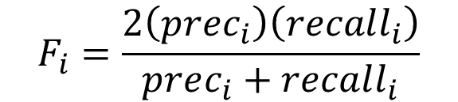
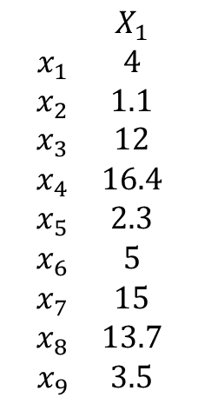
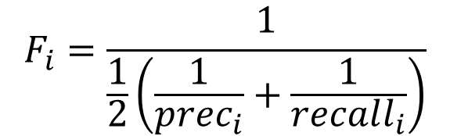
F-score
$$F−score is the harmonic mean of precision and recall$$
$$𝒞=\left\{C_{1},C_{2}\right\}=\left\{\left\{x_{1},x_{2},x_{5},x_{9}\right\},\left\{x_{3},x_{4},x_{6},x_{7},x_{8}\right\}\right\}$$
$1$-dimensional example
$$\begin{matrix} & X_{1} \\ x_{1} & 4 \\ x_{2} & 1.1 \\ x_{3} & 12 \\ x_{4} & 16.4 \\ x_{5} & 2.3 \\ x_{6} & 5 \\ x_{7} & 15 \\ x_{8} & 13.7 \\ x_{9} & 3.5\end{matrix}$$
-1
0
1
2
3
4
5
6
7
8
9
10
11
12
13
14
15
16
17
18
19
20
21
22
$$T_{1}=5$$
$$T_{2}=4$$
$$𝒯=\left\{T_{1},T_{2}\right\}=\left\{\left\{x_{1},x_{2},x_{5},{x_{6},x}_{9}\right\},\left\{x_{3},x_{4}, x_{7},x_{8}\right\}\right\}$$
Contingency table
 | $$T_{1}$$ | $$T_{2}$$
$$C_{1}$$ | 4 | 0
$$C_{2}$$ | 1 | 4
$$recall_{i}=\frac{n_{ij}}{\left|T_{j_{i}}\right|}$$
$$j_{i}=argmax_{j=1}^{k}\left\{n_{ij}\right\}$$
$$F_{i}=\frac{1}{\frac{1}{2}\left(\frac{1}{prec_{i}}+\frac{1}{recall_{i}}\right)}$$
$$prec_{i}=\frac{1}{n}{\max_{j=1}}^{k}\left\{n_{ij}\right\}$$
$$F_{i}=\frac{2\left(prec_{i}\right)\left(recall_{i}\right)}{prec_{i}+recall_{i}}$$
$$n_{ij}=\left|C_{i}∩T_{j}\right|$$
Notes:
reciprocal

Slide 27
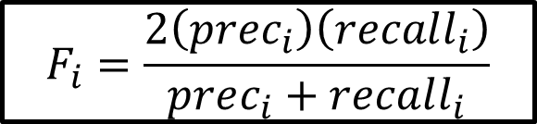

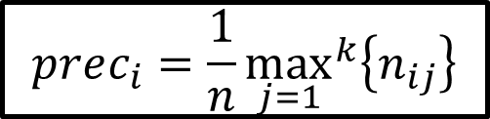


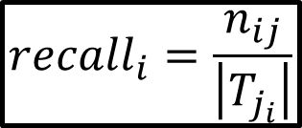

F-score
$$𝒞=\left\{C_{1},C_{2}\right\}=\left\{\left\{x_{1},x_{2},x_{5},x_{9}\right\},\left\{x_{3},x_{4},x_{6},x_{7},x_{8}\right\}\right\}$$
$1$-dimensional example
$${prec}_{1}=\frac{4}{4}=1$$
-1
0
1
2
3
4
5
6
7
8
9
10
11
12
13
14
15
16
17
18
19
20
21
22
$${recall}_{1}=\frac{4}{5}=0.8$$
$$T_{1}=5$$
$$T_{2}=4$$
$$𝒯=\left\{T_{1},T_{2}\right\}=\left\{\left\{x_{1},x_{2},x_{5},{x_{6},x}_{9}\right\},\left\{x_{3},x_{4}, x_{7},x_{8}\right\}\right\}$$
$$F_{1}=\frac{2\left(1\right)\left(0.8\right)}{1+0.8 }=0.89$$
Contingency table
 | $$T_{1}$$ | $$T_{2}$$
$$C_{1}$$ | 4 | 0
$$C_{2}$$ | 1 | 4
$$recall_{i}=\frac{n_{ij}}{\left|T_{j_{i}}\right|}$$
$$j_{i}=argmax_{j=1}^{k}\left\{n_{ij}\right\}$$
$$F_{i}=\frac{2\left(prec_{i}\right)\left(recall_{i}\right)}{prec_{i}+recall_{i}}$$
$$prec_{i}=\frac{1}{n}{\max_{j=1}}^{k}\left\{n_{ij}\right\}$$
$$n_{ij}=\left|C_{i}∩T_{j}\right|$$

Slide 28


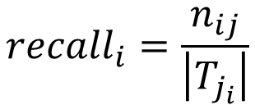

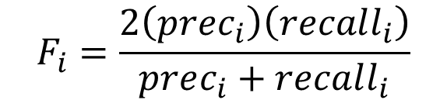
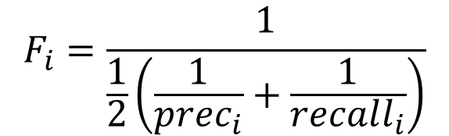
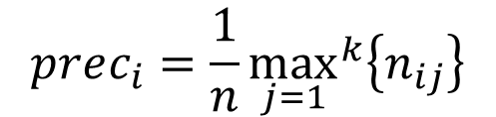

F-score
$$𝒞=\left\{C_{1},C_{2}\right\}=\left\{\left\{x_{1},x_{2},x_{5},x_{9}\right\},\left\{x_{3},x_{4},x_{6},x_{7},x_{8}\right\}\right\}$$
$1$-dimensional example
$${prec}_{2}=\frac{4}{5}=0.8$$
-1
0
1
2
3
4
5
6
7
8
9
10
11
12
13
14
15
16
17
18
19
20
21
22
$${recall}_{2}=\frac{4}{4}=1$$
$$𝒯=\left\{T_{1},T_{2}\right\}=\left\{\left\{x_{1},x_{2},x_{5},{x_{6},x}_{9}\right\},\left\{x_{3},x_{4}, x_{7},x_{8}\right\}\right\}$$
$$F_{2}=\frac{2\left(0.8\right)\left(1\right)}{0.8+1 }=0.89$$
$$recall_{i}=\frac{n_{ij}}{\left|T_{j_{i}}\right|}$$
$$j_{i}=argmax_{j=1}^{k}\left\{n_{ij}\right\}$$
Contingency table
 | $$T_{1}$$ | $$T_{2}$$
$$C_{1}$$ | 4 | 0
$$C_{2}$$ | 1 | 4
$$F_{i}=\frac{1}{\frac{1}{2}\left(\frac{1}{prec_{i}}+\frac{1}{recall_{i}}\right)}$$
$$prec_{i}=\frac{1}{n}{\max_{j=1}}^{k}\left\{n_{ij}\right\}$$
$$F_{i}=\frac{2\left(prec_{i}\right)\left(recall_{i}\right)}{prec_{i}+recall_{i}}$$
$$n_{ij}=\left|C_{i}∩T_{j}\right|$$

Slide 29
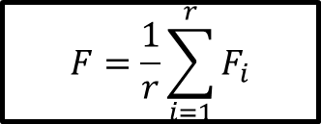
F-score
$$𝒞=\left\{C_{1},C_{2}\right\}=\left\{\left\{x_{1},x_{2},x_{5},x_{9}\right\},\left\{x_{3},x_{4},x_{6},x_{7},x_{8}\right\}\right\}$$
$1$-dimensional example
$$F=\frac{1}{r}\sum_{i=1}^{r}{F_{i}}$$
-1
0
1
2
3
4
5
6
7
8
9
10
11
12
13
14
15
16
17
18
19
20
21
22
$$𝒯=\left\{T_{1},T_{2}\right\}=\left\{\left\{x_{1},x_{2},x_{5},{x_{6},x}_{9}\right\},\left\{x_{3},x_{4}, x_{7},x_{8}\right\}\right\}$$
$$recall_{i}=\frac{n_{ij}}{\left|T_{j_{i}}\right|}$$
$$j_{i}=argmax_{j=1}^{k}\left\{n_{ij}\right\}$$
Contingency table
 | $$T_{1}$$ | $$T_{2}$$
$$C_{1}$$ | 4 | 0
$$C_{2}$$ | 1 | 4
$$F_{i}=\frac{1}{\frac{1}{2}\left(\frac{1}{prec_{i}}+\frac{1}{recall_{i}}\right)}$$
$$prec_{i}=\frac{1}{n}{\max_{j=1}}^{k}\left\{n_{ij}\right\}$$
$$F_{i}=\frac{2\left(prec_{i}\right)\left(recall_{i}\right)}{prec_{i}+recall_{i}}$$
$$n_{ij}=\left|C_{i}∩T_{j}\right|$$

Slide 30

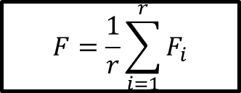

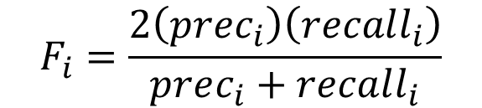
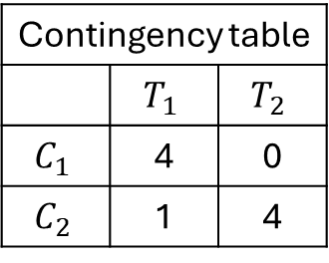
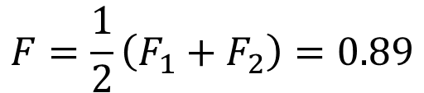

F-score
$$𝒞=\left\{C_{1},C_{2}\right\}=\left\{\left\{x_{1},x_{2},x_{5},x_{9}\right\},\left\{x_{3},x_{4},x_{6},x_{7},x_{8}\right\}\right\}$$
$1$-dimensional example
$$F=\frac{1}{r}\sum_{i=1}^{r}{F_{i}}$$
-1
0
1
2
3
4
5
6
7
8
9
10
11
12
13
14
15
16
17
18
19
20
21
22
Contingency table
 | $$T_{1}$$ | $$T_{2}$$
$$C_{1}$$ | 4 | 0
$$C_{2}$$ | 1 | 4
$$𝒯=\left\{T_{1},T_{2}\right\}=\left\{\left\{x_{1},x_{2},x_{5},{x_{6},x}_{9}\right\},\left\{x_{3},x_{4}, x_{7},x_{8}\right\}\right\}$$
$$n_{ij}=\left|C_{i}∩T_{j}\right|$$
$$j_{i}=argmax_{j=1}^{k}\left\{n_{ij}\right\}$$
$$recall_{i}=\frac{n_{ij}}{\left|T_{j_{i}}\right|}$$
$$F_{i}=\frac{1}{\frac{1}{2}\left(\frac{1}{prec_{i}}+\frac{1}{recall_{i}}\right)}$$
$$F_{1}=0.89$$
$$prec_{i}=\frac{1}{n}{\max_{j=1}}^{k}\left\{n_{ij}\right\}$$
$$F_{2}=0.89$$
$$F=\frac{1}{2}\left(F_{1}+F_{2}\right)=0.89$$
$$F_{i}=\frac{2\left(prec_{i}\right)\left(recall_{i}\right)}{prec_{i}+recall_{i}}$$

Slide 31
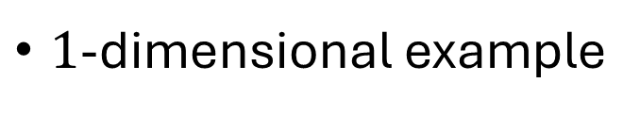
F-score - exercise
$1$-dimensional example
$$𝒞=\left\{C_{1},C_{2}\right\}=\left\{\left\{x_{2},x_{5}\right\},\left\{x_{1},x_{3},x_{4},x_{6},x_{7},x_{8},x_{9}\right\}\right\}$$
-1
0
1
2
3
4
5
6
7
8
9
10
11
12
13
14
15
16
17
18
19
20
21
22
$$𝒯=\left\{T_{1},T_{2}\right\}=\left\{\left\{x_{1},x_{2},x_{5},{x_{6},x}_{9}\right\},\left\{x_{3},x_{4}, x_{7},x_{8}\right\}\right\}$$

Slide 32
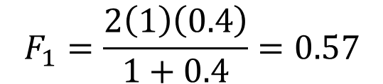
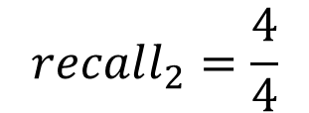

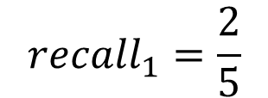
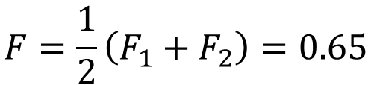

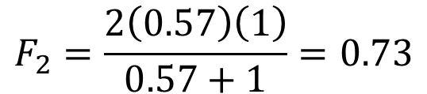

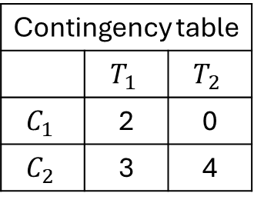

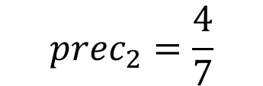
F-score
$$𝒞=\left\{C_{1},C_{2}\right\}=\left\{\left\{x_{2},x_{5}\right\},\left\{x_{1},x_{3},x_{4},x_{6},x_{7},x_{8},x_{9}\right\}\right\}$$
$1$-dimensional example
Contingency table
 | $$T_{1}$$ | $$T_{2}$$
$$C_{1}$$ | 2 | 0
$$C_{2}$$ | 3 | 4
-1
0
1
2
3
4
5
6
7
8
9
10
11
12
13
14
15
16
17
18
19
20
21
22
$$𝒯=\left\{T_{1},T_{2}\right\}=\left\{\left\{x_{1},x_{2},x_{5},{x_{6},x}_{9}\right\},\left\{x_{3},x_{4}, x_{7},x_{8}\right\}\right\}$$
$$F_{1}=0.57$$
$$n_{ij}=\left|C_{i}∩T_{j}\right|$$
$$F_{2}=0.73$$
$$recall_{1}=\frac{2}{5}$$
$$recall_{2}=\frac{4}{4}$$
$$F=\frac{1}{2}\left(F_{1}+F_{2}\right)=0.65$$
$$prec_{1}=1$$
$$prec_{2}=\frac{4}{7}$$
$$F_{1}=\frac{2\left(1\right)\left(0.4\right)}{1+0.4}=0.57$$
$$F_{2}=\frac{2\left(0.57\right)\left(1\right)}{0.57+1}=0.73$$

